Slide 1
Chapter 4 Interfacing
Er. साहित बराल
June 28/2021

Slide 2
Outline
Communication basics
Microprocessor interfacing
  I/O Addressing
  Interrupts
  Direct memory access
Arbitration
Multilevel Bus Architecture
Advanced Communication Principles
Protocols
  Serial
  Parallel
  Wireless

Slide 3
Introduction
Embedded system functionality aspects
  Processing
    Transformation of data
    Implemented using processors
  Storage
    Retention of data
    Implemented using memory
  Communication
    Transfer of data between processors and memories
    Implemented using buses
    Called interfacing

Slide 4
Communication Basics
Basic Terminology
1. Wires:
  Uni-directional or bi-directional
  One line may represent multiple wires
2. Bus
  Set of wires with a single function
    Address bus, data bus
  Or, entire collection of wires
    Address, data and control
    Associated protocol: rules for communication
rd'/wr
Processor
Memory
enable
addr[0-11]
data[0-7]
bus
bus structure

Slide 5
Communication Basics
Processor
rd'/wr
Memory
port
enable
addr[0-11]
data[0-7]
3. Ports
Conducting device on periphery which connects bus to processor or memory
Often referred to as a pin
  Actual pins on periphery of IC package that plug into socket on printed-circuit board
  Sometimes metallic balls instead of pins
  Today, metal “pads” connecting processors and memories within single IC
Single wire or set of wires with single function
  E.g., 12-wire address port
bus

Slide 6
Communication Basics
4. Timing diagram
Most common method for describing a communication protocol
Time proceeds to the right on x-axis
Control signal: low or high
  May be active low (e.g., go’, /go, or go_L)
  Use terms assert (active) and deassert
  Asserting go’ means go=0
Data signal: not valid or valid
Protocol may have subprotocols
  Called bus cycle, e.g., read and write
  Each may be several clock cycles

Slide 7
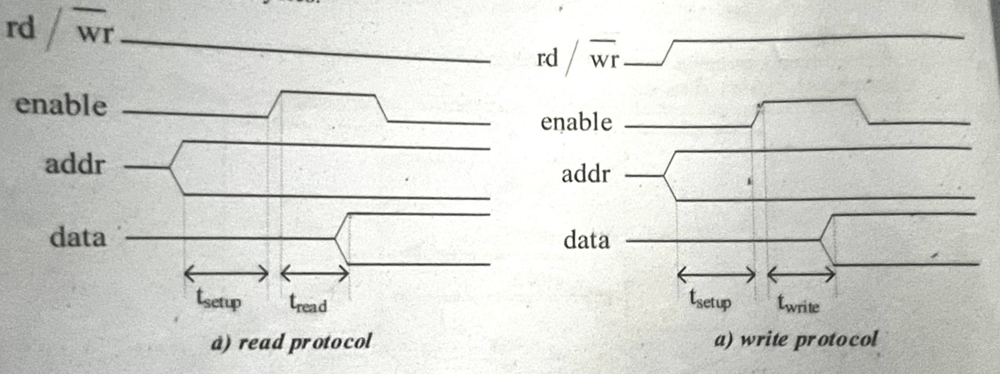
Communication Basics
4. Timing diagram
Read example
  Processor set rd’/wr to low and place valid address on address line for at least t_{setup} time before enable asserted
  Enable triggers memory to place data on data wires by time t_{read}

Slide 8
Basic protocol concepts
Actor: master initiates, servant (slave) respond
Data Direction: sender, receiver
Addresses: special kind of data
  Specifies a location in memory, a peripheral, or a register within a peripheral
Time multiplexing
  Share a single set of wires for multiple pieces of data
  Saves wires at expense of time
Time-multiplexed data transfer
Master
req
Servant
Master
req
Servant
data(15:0)
data(15:0)
addr
data
addr
data
mux
data(8)
demux
mux
addr/data
demux
req
req
data
15:8
7:0
addr/data
addr
data
data serializing
address/data muxing

Slide 9
Basic protocol concepts: control methods
Master
req
Servant
Master
req
Servant
ack
data
data
req
1
3
req
1
3
data
2
4
ack
2
4
data
t_{access}
Master asserts req to receive data
Servant puts data on bus within time t_{access}
Master receives data and deasserts req
Servant ready for next request
Master asserts req to receive data
2. Servant puts data on bus and
asserts ack
3. Master receives data and
deasserts req
4. Servant ready for next request
Strobe protocol
Handshake protocol

Slide 10
A strobe/handshake compromise
Master
req
Servant
wait
data
req
1
3
req
1
4
wait
wait
2
3
data
2
4
data
5
t_{access}
t_{access}
Master asserts req to receive data
2. Servant puts data on bus
within time t_{access}
(wait line is unused)
3. Master receives data and
deasserts req
4. Servant ready for next
request
Master asserts req to receive data
2. Servant can't put data within
t_{access}, asserts wait ack
3. Servant puts data on bus and
deasserts wait
4. Master receives data and
deasserts req
5. Servant ready for next
request
Fast-response case
Slow-response case

Slide 11
ISA bus protocol – memory access
ISA: Industry Standard Architecture
  Common in 80x86’s microprocessor
Features
  20-bit memory address
  Compromise strobe/handshake control protocol used for both read and write
  4 cycles default
  Unless CHRDY deasserted – resulting in additional wait cycles (up to 6)

Slide 12
ISA bus protocol – memory read
Microprocessor
Memory
I/O Device
ISA bus
memory-read bus cycle
CYCLE
CLOCK
D[7-0]
A[19-0]
ALE
/MEMR
CHRDY
C1 C2 WAIT C3 C4
DATA
ADDRESS
  In C1, microprocessor (mp) puts a 20 bit memory address on address lines A and asserts ALE.
  During C2 and C3, processor asserts memory read signal MEMR to request a read operation from memory device.
  After C3, memory device holds data on data lines D.
  In C4 all signals are deasserted.
  The memory device deasserted the CHRDY signal before the rising clock edge in C2;causing up to insert wait cycles until CHRDY was reasserted.
Notes:
ALE (Address Enable Latch) is the control signal which is nothing but a positive going pulse generated when a new operation is started by microprocessor. So when pulse goes high means ALE=1, it makes address bus enable and when ALE=0, means low pulse makes data bus enable

Slide 13
ISA bus protocol – memory write
Microprocessor
Memory
I/O Device
ISA bus
memory-write bus cycle
CYCLE
CLOCK
D[7-0]
A[19-0]
ALE
/MEMW
CHRDY
C1 C2 WAIT C3 C4
DATA
ADDRESS
  In C1, processor puts 20-bit address memory address on the address line and asserts ALE signal.
  During C2 and C3, the processor puts the data on the data line and asserts MEMW signal to enable write operation. However, if the memory, when not ready, desserts CHRDY signal in C2 then processor inserts wait cycles until CHRDY is reasserted.
  In cycle C4, all signals are deasserted.
Notes:
ALE (Address Enable Latch) is the control signal which is nothing but a positive going pulse generated when a new operation is started by microprocessor. So when pulse goes high means ALE=1, it makes address bus enable and when ALE=0, means low pulse makes data bus enable

Slide 14
Microprocessor interfacing: I/O addressing
A microprocessor communicates with other devices using some of its pins
I/O addressing basically includes how I/O devices are connected to the bus structure, how address spaces assigned into I/O peripherals and how communication is performed between processor an peripherals
  Port-based I/O (parallel I/O)
  Bus-based I/O

Slide 15
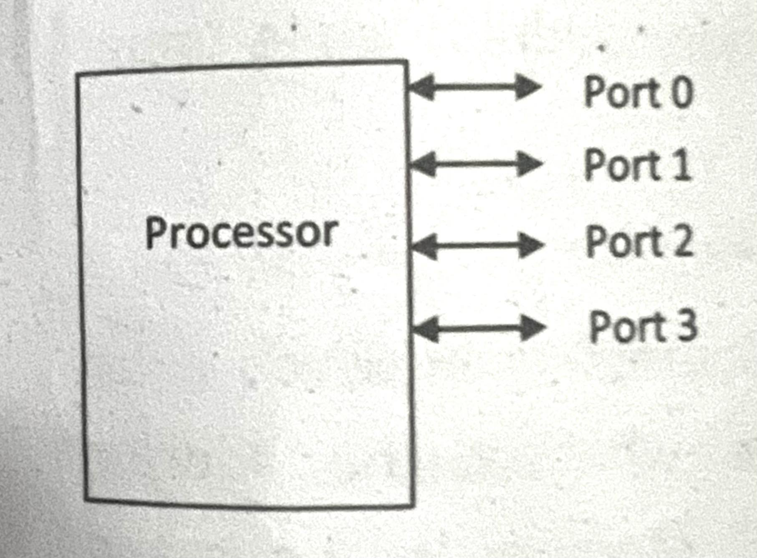
Microprocessor interfacing: I/O addressing
Port-based I/O (parallel I/O)
  A processor has one or more n-bit ports.
  A port can be directly read and written by processor instructions just like any other register in the microprocessor.
  A port is usually connected to a dedicated register.
  In programming language, writing to a port may look like P0 = 255, which would set all the 8-pins of port 0 to 1.
  Reading a value form a port to a variable may look like x = P0.
  Ports are often bit addressable meaning that a programmer can read or write specific bits of the port.
  For example, one might say: X = P0.2,
  giving x the value of the
  number 2 connection of port P0.

Slide 16
Microprocessor interfacing: I/O addressing
Extended Port-based I/O (parallel I/O)
When processor supports port-based I/O but more ports needed
One or more processor ports interface with parallel I/O peripheral extending total number of ports available for I/O
e.g., extending 4 ports to 6 ports in figure
Processor
Port 0
Port 1
Port 2
Port 3
Parallel I/O peripheral
Port A
Port B
Port C
Extended parallel I/O

Slide 17
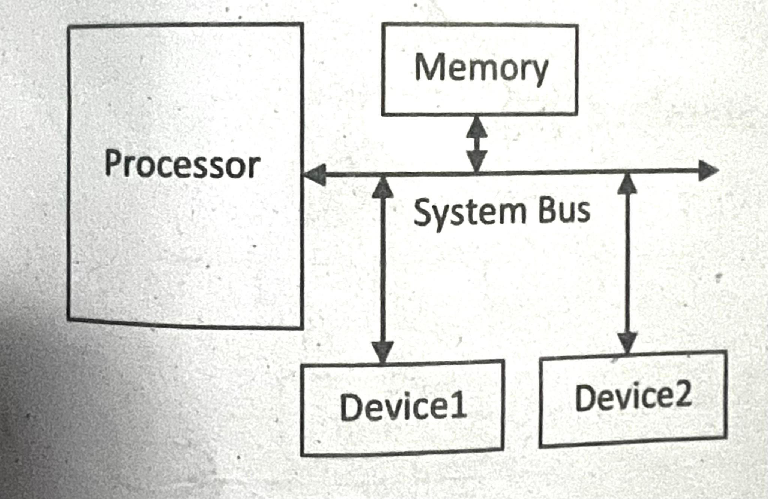
Microprocessor interfacing: I/O addressing
2. Bus-based I/O
  Processor has address, data and control ports that form a single bus to access memory as well as peripherals
  Communication protocol is built into the processor
  A single instruction carries out the read or write protocol on the bus
  Processor talks to both memory and peripherals using same bus
    Two ways to talk to peripherals
    Memory-mapped I/O and Standard I/O

Slide 18
Microprocessor interfacing: I/O addressing
Extended Bus-based I/O with parallel I/O operations
  When processor only supports bus-based I/O but parallel I/O needed
  Each port on peripheral connected to a register within peripheral that is read/written by the processor
Processor
Memory
System bus
Parallel I/O peripheral
Port A
Port B
Port C
Adding parallel I/O to a bus-based I/O processor

Slide 19
Memory-mapped I/O
Memory-mapped I/O is a type of bus-based I/O addressing for a processor to communicate with peripherals in which peripherals are addressed using the specific existing address space.
The total address space is divided into memory address and peripheral address.
Also, no special Instructions for peripherals are required for data transfer, since instructions like MOV , ADD used for memory will also work with peripherals.
Example: A bus with 16 bit have total of 65536 addresses. So, lower
32768 addresses may correspond to memory address
while upper 32768 correspond to I/O addresses.

Slide 20
Standard I/O
Standard I/O is a type of bus-based I/O addressing in which extra control line (M/IO) is used to indicate whether the address represents memory location or peripheral.
This addressing, however, requires special instructions. MOV, LOAD instructions for memory while IN, OUT for peripherals.
Also the address decoding logic for peripherals is simple as the high order address bits can be ignore when the number of peripherals is less.
Example: A bus with 16 bit have total of 65536 addresses. All 65536 addresses can be used to address memory and peripheral. The M/IO line is used to select either memory or peripheral.
  If M/IO is zero then the address on the address bus corresponds to a memory address.

Slide 21
(Industry standard architecture) ISA bus
ISA supports standard I/O
  /IOR for peripheral read
  /IOW used for writes
ISA I/O bus read protocol
CYCLE
CLOCK
D[7-0]
A[15-0]
ALE
/IOR
CHRDY
C1 C2 WAIT C3 C4
DATA
ADDRESS

Slide 22
Interrupts – Interrupt Driven I/O
The peripherals may require service from the processor which is very much unpredictable. So there is an issue on how to serve the peripherals by the processor as it remains busy on its own task.
Polling and interrupts are two basic methods to address that issue

Slide 23
Microprocessor interfacing: interrupts
Polling
Polling is a method in which the processor checks for service requirement of every peripheral.
This method, though, is easier and simple to implement, the repeated checking, however, wastes many clock cycles which could have been used to do certain useful work.

Slide 24
Microprocessor interfacing: interrupts
Interrupt
The peripheral can interrupt the processor when it has data. It requires a microprocessor with an extra pin or pins: Int (external interrupt).
If Int = 1, processor suspends current program, jumps to an Interrupt Service Routine (ISR). Such I/O is known as interrupt driven I/O.
At the end of each machine instruction, the processor's controller checks Int, if Int is asserted the up Jumps to a particular address at which an ISR exists.

Slide 25
Microprocessor interfacing: interrupts
What is the address (interrupt address vector) of the ISR?
  Fixed interrupt
    Address built into microprocessor, cannot be changed
    Either ISR stored at address or a jump to actual ISR stored if not enough bytes available
  Vectored interrupt
    Peripheral must provide the address
    Common when microprocessor has multiple peripherals connected by a system bus
  Compromise: interrupt address table

Slide 26
Interrupt-driven I/O using fixed ISR location
Time
1(a): μP is executing its main program.
1(b): P1 receives input data in a register with address 0x8000.
2: P1 asserts Int to request servicing by the microprocessor.
3: After completing instruction at 100, μP sees Int asserted, saves the PC’s value of 100, and sets PC to the ISR fixed location of 16.
4(a): The ISR reads data from 0x8000, modifies the data, and writes the resulting data to 0x8001.
4(b): After being read, P1 de-asserts Int.
5: The ISR returns, thus restoring PC to 100+1=101, where μP resumes executing.

Slide 27
Interrupt-driven I/O using fixed ISR location
1(a): μP is executing its main program
1(b): P1 receives input data in a register with address 0x8000.
Program memory
μP
Data memory
ISR
16:
MOV R0, 0x8000
System bus
17:
# modifies R0
18:
MOV 0x8001, R0
19:
RETI # ISR return
...
Int
P1
P2
Main program
...
PC
0x8000
0x8001
100:
instruction
101:
instruction

Slide 28
Interrupt-driven I/O using fixed ISR location
2: P1 asserts Int to request servicing by the microprocessor
Program memory
μP
Data memory
ISR
16:
MOV R0, 0x8000
System bus
17:
# modifies R0
18:
MOV 0x8001, R0
19:
RETI # ISR return
...
Int
P1
P2
Int
Main program
1
...
PC
0x8000
0x8001
100:
instruction
101:
instruction

Slide 29
Interrupt-driven I/O using fixed ISR location
3: After completing instruction at 100, μP sees Int asserted, saves the PC’s value of 100, and sets PC to the ISR fixed location of 16.
Program memory
μP
Data memory
ISR
16:
MOV R0, 0x8000
System bus
17:
# modifies R0
18:
MOV 0x8001, R0
19:
RETI # ISR return
...
Int
P1
P2
Main program
...
PC
0x8000
0x8001
100:
instruction
100
101:
instruction
100

Slide 30
Interrupt-driven I/O using fixed ISR location
4(a): The ISR reads data from 0x8000, modifies the data, and writes the resulting data to 0x8001.
4(b): After being read, P1 deasserts Int.
Program memory
μP
Data memory
ISR
16:
MOV R0, 0x8000
System bus
17:
# modifies R0
System bus
18:
MOV 0x8001, R0
19:
RETI # ISR return
...
P1
P1
P1
P2
Int
P2
Int
Main program
0
...
PC
0x8000
0x8000
0x8001
100:
instruction
0x8001
101:
instruction
100

Slide 31
Interrupt-driven I/O using fixed ISR location
5: The ISR returns, thus restoring PC to 100+1=101, where μP resumes executing.
Program memory
μP
Data memory
ISR
ISR
16:
MOV R0, 0x8000
16:
MOV R0, 0x8000
System bus
17:
17:
# modifies R0
# modifies R0
18:
18:
MOV 0x8001, R0
MOV 0x8001, R0
19:
19:
RETI # ISR return
...
RETI # ISR return
...
Int
P1
P2
Main program
Main program
...
...
PC
0x8000
0x8001
100:
instruction
100:
instruction
+1
100
100
101:
instruction
100
101:
instruction

Slide 32
Interrupt-driven I/O using vectored interrupt
1(a): μP is executing its main program.
1(b): P1 receives input data in a register with address 0x8000.
Time
2: P1 asserts Int to request servicing by the microprocessor.
3: After completing instruction at 100, μP sees Int asserted, saves the PC’s value of 100, and asserts Inta.
4: P1 detects Inta and puts interrupt address vector 16 on the data bus.
5(a): μP jumps to the address on the bus (16). The ISR there reads data from 0x8000, modifies the data, and writes the resulting data to 0x8001.
5(b): After being read, P1 deasserts Int.
6: The ISR returns, thus restoring PC to 100+1=101, where μP resumes executing.

Slide 33
Interrupt-driven I/O using vectored interrupt
1(a): P is executing its main program
1(b): P1 receives input data in a register with address 0x8000.
Program memory
μP
Data memory
ISR
16:
MOV R0, 0x8000
System bus
17:
# modifies R0
18:
MOV 0x8001, R0
19:
RETI # ISR return
...
Inta
P1
P2
Main program
Int
...
PC
16
100:
instruction
0x8000
0x8001
101:
instruction
100

Slide 34
Interrupt-driven I/O using vectored interrupt
2: P1 asserts Int to request servicing by the microprocessor
Program memory
μP
Data memory
ISR
16:
MOV R0, 0x8000
System bus
17:
# modifies R0
18:
MOV 0x8001, R0
19:
RETI # ISR return
...
Inta
P1
P2
Int
Main program
Int
...
PC
1
16
100:
instruction
0x8000
0x8001
101:
instruction
100

Slide 35
Interrupt-driven I/O using vectored interrupt
3: After completing instruction at 100, μP sees Int asserted, saves the PC’s value of 100, and asserts Inta
Program memory
μP
Data memory
ISR
16:
MOV R0, 0x8000
System bus
17:
# modifies R0
18:
MOV 0x8001, R0
19:
RETI # ISR return
1
...
Inta
Inta
P1
P2
Main program
Int
...
PC
16
100:
instruction
0x8000
0x8001
100
101:
instruction
100

Slide 36
Interrupt-driven I/O using vectored interrupt
4: P1 detects Inta and puts interrupt address vector 16 on the data bus
Program memory
μP
Data memory
ISR
16:
MOV R0, 0x8000
System bus
17:
# modifies R0
16
System bus
18:
MOV 0x8001, R0
19:
RETI # ISR return
...
Inta
P1
P2
Main program
Int
16
...
PC
16
100:
instruction
0x8000
0x8001
101:
instruction
100

Slide 37
Interrupt-driven I/O using vectored interrupt
5(a): PC jumps to the address on the bus (16). The ISR there reads data from 0x8000, modifies the data, and writes the resulting data to 0x8001.
5(b): After being read, P1 deasserts Int.
Program memory
μP
Data memory
ISR
ISR
16:
MOV R0, 0x8000
16:
MOV R0, 0x8000
System bus
17:
# modifies R0
System bus
17:
# modifies R0
18:
18:
MOV 0x8001, R0
MOV 0x8001, R0
19:
19:
RETI # ISR return
...
RETI # ISR return
...
Inta
P1
P1
P2
Int
P2
Main program
Int
Main program
16
...
...
PC
0
100:
instruction
100:
instruction
0x8000
0x8000
0x8001
100
0x8001
101:
101:
instruction
instruction

Slide 38
Interrupt-driven I/O using vectored interrupt
6: The ISR returns, thus restoring the PC to 100+1=101, where the μP resumes
Program memory
μP
Data memory
ISR
ISR
16:
MOV R0, 0x8000
16:
MOV R0, 0x8000
System bus
17:
17:
# modifies R0
# modifies R0
18:
18:
MOV 0x8001, R0
MOV 0x8001, R0
19:
19:
RETI # ISR return
...
RETI # ISR return
...
Int
P1
P2
Main program
Main program
...
...
PC
0x8000
0x8001
100:
instruction
100:
instruction
+1
100
100
101:
instruction
100
101:
instruction

Slide 39
Interrupt address table
Compromise between fixed and vectored interrupts
  One interrupt pin
  Table in memory holding ISR addresses (maybe 256 words)
  Peripheral doesn’t provide ISR address, but rather index into table
    Fewer bits are sent by the peripheral
    Can move ISR location without changing peripheral

Slide 40
Additional interrupt issues
Maskable vs. non-maskable interrupts
  Maskable: programmer can set bit that causes processor to ignore interrupt
    Important when in the middle of time-critical code
  Non-maskable: a separate interrupt pin that can’t be masked
    Typically reserved for drastic situations, like power failure requiring immediate backup of data to non-volatile memory
Internal Interrupts:
  It results from an exceptional condition such as divide by 0, or execution of an invalid op code. These are also called traps.
Software Interrupt:
  It is a third type of interrupt (external interrupt and internal interrupt being first and second type) that can be initiated by executing a special assembly instruction.

Slide 41
Direct memory access
Buffering:
  Commonly, the data being accumulated in a peripheral should be first stored in memory before being processed by a program running on the microprocessor, Such temporary storage of data that is waiting for processing is called buffering,
Microprocessor could handle this with ISR:
  ISR would simply transfer data from the peripheral to the memory, and then resume its application.
  But storing and restoring microprocessor state may consume many clock cycles and is thus inefficient. Also the mp cannot execute Its regular program efficiently.
  The I/O method of Direct Memory Access (DMA) eliminates these inefficiencies of interrupt driven IO

Slide 42
Peripheral to memory transfer without DMA, using vectored interrupt
Time
1(a): μP is executing its main program.
1(b): P1 receives input data in a register with address 0x8000.
2: P1 asserts Int to request servicing by the microprocessor.
3: After completing instruction at 100, μP sees Int asserted, saves the PC’s value of 100, and asserts Inta.
4: P1 detects Inta and puts interrupt address vector 16 on the data bus.
5(a): μP jumps to the address on the bus (16). The ISR there reads data from 0x8000 and then writes it to 0x0001, which is in memory.
5(b): After being read, P1 deasserts Int.
6: The ISR returns, thus restoring PC to 100+1=101, where μP resumes executing.

Slide 43
1(a): μP is executing its main program
1(b): P1 receives input data in a register with address 0x8000.
Program memory
μP
Data memory
ISR
0x0000
0x0001
16:
MOV R0, 0x8000
17:
# modifies R0
18:
MOV 0x0001, R0
System bus
19:
RETI # ISR return
...
Main program
Inta
P1
...
Int
100:
instruction
16
101:
instruction
PC
0x8000

Slide 44
Peripheral to memory transfer without DMA, using vectored interrupt
2: P1 asserts Int to request servicing by the microprocessor
Program memory
μP
Data memory
ISR
0x0000
0x0001
16:
MOV R0, 0x8000
17:
# modifies R0
18:
MOV 0x0001, R0
System bus
19:
RETI # ISR return
...
Main program
Inta
P1
...
Int
100:
instruction
Int
16
101:
instruction
PC
1
0x8000
100

Slide 45
Peripheral to memory transfer without DMA, using vectored interrupt
3: After completing instruction at 100, μP sees Int asserted, saves the PC’s value of 100, and asserts Inta.
Program memory
μP
Data memory
ISR
0x0000
0x0001
16:
MOV R0, 0x8000
17:
# modifies R0
18:
MOV 0x0001, R0
System bus
19:
RETI # ISR return
...
1
Inta
Main program
Inta
P1
...
Int
100:
instruction
16
101:
instruction
PC
0x8000
100
100

Slide 46
Peripheral to memory transfer without DMA, using vectored interrupt (cont’)
4: P1 detects Inta and puts interrupt address vector 16 on the data bus.
Program memory
μP
Data memory
ISR
0x0000
0x0001
16:
MOV R0, 0x8000
17:
# modifies R0
System bus
18:
MOV 0x0001, R0
16
System bus
19:
RETI # ISR return
...
Main program
Inta
P1
...
Int
16
100:
instruction
16
101:
instruction
PC
0x8000
100

Slide 47
Peripheral to memory transfer without DMA, using vectored interrupt (cont’)
5(a): μP jumps to the address on the bus (16). The ISR there reads data from 0x8000 and then writes it to 0x0001, which is in memory.
5(b): After being read, P1 de-asserts Int.
μP
Data memory
Program memory
Data memory
0x0000
0x0001
ISR
0x0001
ISR
ISR
16:
16:
16:
MOV R0, 0x8000
MOV R0, 0x8000
MOV R0, 0x8000
17:
17:
17:
# modifies R0
# modifies R0
# modifies R0
System bus
18:
System bus
18:
18:
MOV 0x8001, R0
MOV 0x8001, R0
MOV 0x0001, R0
19:
19:
19:
RETI # ISR return
RETI # ISR return
...
RETI # ISR return
...
...
Main program
Inta
Main program
Main program
P1
...
P1
...
...
Int
100:
Int
16
100:
100:
instruction
instruction
instruction
PC
0
101:
101:
101:
instruction
instruction
instruction
0x8000
0x8000
100

Slide 48
Peripheral to memory transfer without DMA, using vectored interrupt (cont’)
6: The ISR returns, thus restoring PC to 100+1=101, where μP resumes executing.
Program memory
μP
Data memory
ISR
0x0000
0x0001
ISR
16:
16:
MOV R0, 0x8000
MOV R0, 0x8000
17:
17:
# modifies R0
# modifies R0
18:
System bus
18:
MOV 0x8001, R0
MOV 0x0001, R0
19:
19:
RETI # ISR return
...
RETI # ISR return
...
Main program
Inta
Main program
P1
...
...
Int
100:
16
100:
instruction
instruction
PC
101:
101:
instruction
instruction
+1
0x8000
100
100

Slide 49
Direct memory access
DMA controller
It Is a single purpose processor (SPP) whose sole purpose is to transfer data between memories and peripherals. It is used in DMA.
The peripherals request servicing from the DMA controller, which then requests control of the system bus from the microprocessor.
Microprocessor relinquishes control of system bus to the DMA controller. Microprocessor does not need to jump to an ISR, so overhead of storing and restoring the up state is eliminated.
Microprocessor mean while can execute its regular program, as long as that regular program does not require use of the system bus.
We connect the peripheral to the DMA controller rather than mp.

Slide 50
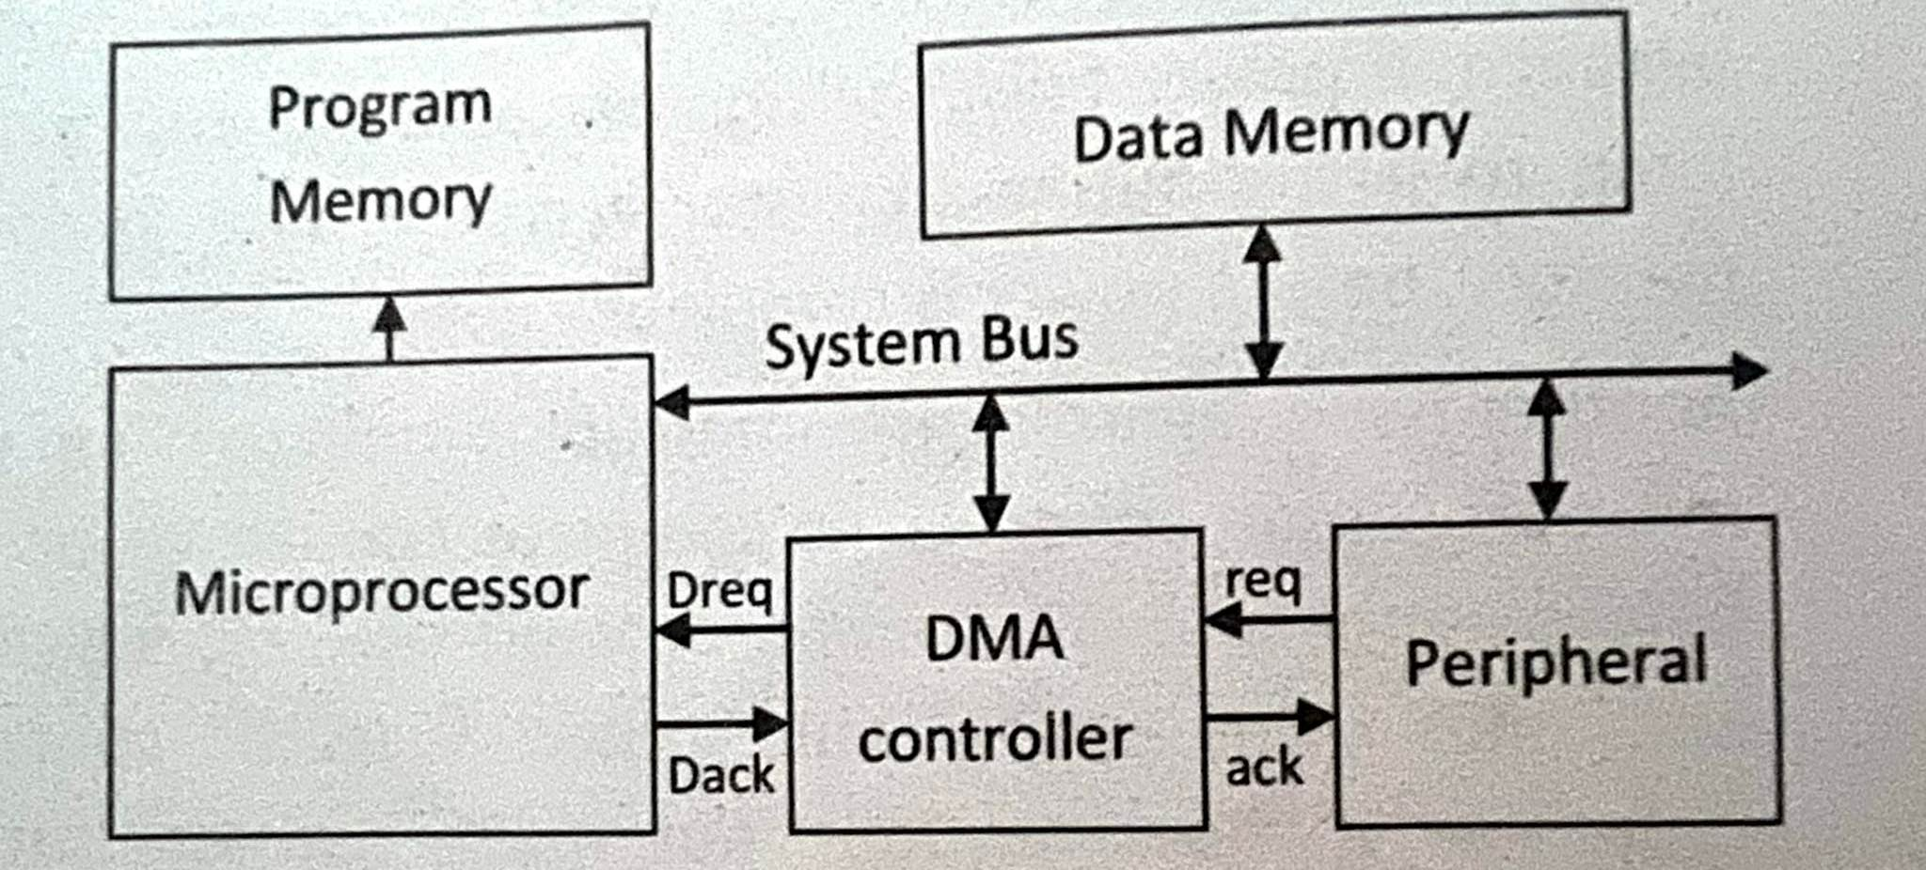
Direct memory access
DMA controller
DMA controller is connected to the two special pins of up.
Dreq: Used by the DMA controller to request control of the bus.
Dack: Used by the up to acknowledge to the DMA controller
that bus control has been granted.

Slide 51
Peripheral to memory transfer with DMA
1(a): μP is executing its main program. It has already configured the DMA ctrl registers.
1(b): P1 receives input data in a register with address 0x8000.
Time
4: After executing instruction 100, μP sees Dreq asserted, releases the system bus, asserts Dack, and resumes execution. μP stalls only if it needs the system bus to continue executing.
3: DMA ctrl asserts Dreq to request control of system bus.
2: P1 asserts req to request servicing by DMA ctrl.
5: (a) DMA ctrl asserts ack (b) reads data from 0x8000 and (b) writes that data to 0x0001.
6:. DMA de-asserts Dreq and ack completing handshake with P1.
7(a): μP de-asserts Dack and resumes control of the bus.
7(b): P1 de-asserts req.

Slide 52
Peripheral to memory transfer with DMA (cont’)
1(a): μP is executing its main program. It has already configured the DMA ctrl registers
1(b): P1 receives input data in a register with address 0x8000.
Program memory
μP
Data memory
0x0000
0x0001
No ISR needed!
System bus
...
Dack
DMA ctrl
P1
Main program
Dreq
...
0x0001
ack
100:
instruction
PC
0x8000
req
101:
instruction
0x8000
100

Slide 53
Peripheral to memory transfer with DMA (cont’)
2: P1 asserts req to request servicing
by DMA ctrl.
3: DMA ctrl asserts Dreq to request control of system bus
Program memory
μP
Data memory
0x0000
0x0001
No ISR needed!
System bus
...
Dack
DMA ctrl
DMA ctrl
P1
P1
Main program
Dreq
P1
...
Dreq
0x0001
ack
100:
instruction
1
PC
req
101:
instruction
0x8000
req
0x8000
100
1

Slide 54
Peripheral to memory transfer with DMA (cont’)
4: After executing instruction 100, μP sees Dreq asserted, releases the system bus, asserts Dack, and resumes execution, μP stalls only if it needs the system bus to continue executing.
Program memory
μP
Data memory
0x0000
0x0001
No ISR needed!
System bus
...
Dack
1
Main program
Dack
DMA ctrl
P1
...
Dreq
0x0001
ack
100:
instruction
PC
0x8000
req
101:
instruction
0x8000
100

Slide 55
Peripheral to memory transfer with DMA (cont’)
5: DMA ctrl (a) asserts ack, (b) reads data from 0x8000, and (c) writes that data to 0x0001.
(Meanwhile, processor still executing if not stalled!)
μP
Data memory
Program memory
Data memory
0x0000
0x0001
0x0000
0x0001
No ISR needed!
System bus
System bus
...
Dack
DMA ctrl
P1
Main program
Dreq
DMA ctrl
1
P1
...
ack
ack
0x0001
ack
0x0001
100:
instruction
PC
req
0x8000
req
0x8000
0x8000
101:
instruction
0x8000
100

Slide 56
Peripheral to memory transfer with DMA (cont’)
6: DMA de-asserts Dreq and ack completing the handshake with P1.
Program memory
μP
Data memory
0x0000
0x0001
No ISR needed!
System bus
...
Dack
DMA ctrl
P1
Main program
Dreq
0
...
Dreq
ack
0
0x0001
ack
100:
instruction
PC
0x8000
req
101:
instruction
0x8000
100

Slide 57
ISA bus DMA cycles
Processor
Memory
ISA-Bus
R
A
R
DMA
A
I/O Device
DMA Memory-Write Bus Cycle
DMA Memory-Read Bus Cycle
CYCLE
CLOCK
D[7-0]
A[19-0]
ALE
/IOR
/MEMW
CHRDY
C1 C2 C3 C4 C5 C6 C7
CYCLE
CLOCK
D[7-0]
A[19-0]
ALE
/MEMR
/IOW
CHRDY
C1 C2 C3 C4 C5 C6 C7
DATA
DATA
ADDRESS
ADDRESS

Slide 58
Arbitration: Priority arbiter
Consider the situation where multiple peripherals request service from single resource (e.g., microprocessor, DMA controller) simultaneously - which gets serviced first?
Priority arbiter
  Single-purpose processor
  Peripherals make requests to arbiter, arbiter makes requests to resource
  Arbiter connected to system bus for configuration only
Micro-processor
System bus
7
Inta
5
Priority
arbiter
Peripheral1
Peripheral2
Int
3
Ireq1
2
2
Iack1
6
Ireq2
Iack2

Slide 59
Arbitration using a priority arbiter
Micro-processor
System bus
7
Inta
5
Priority
arbiter
Peripheral1
Peripheral2
Int
3
Ireq1
2
2
Iack1
6
Ireq2
Iack2
1. Microprocessor is executing its program.
2. Peripheral1 needs servicing so asserts Ireq1. Peripheral2 also needs
servicing so asserts Ireq2.
3. Priority arbiter sees at least one Ireq input asserted, so asserts Int.
4. Microprocessor stops executing its program and stores its state.
5. Microprocessor asserts Inta.
6. Priority arbiter asserts Iack1 to acknowledge Peripheral1.
7. Peripheral1 puts its interrupt address vector on the system bus
8. Microprocessor jumps to the address of ISR read from data bus,
ISR executes and returns (and completes handshake with arbiter).
9. Microprocessor resumes executing its program.

Slide 60
Arbitration: Priority arbiter
Types of priority
  Fixed priority
    Each peripheral has unique rank
    Highest rank chosen first with simultaneous requests
    Preferred when clear difference in rank between peripherals
  Rotating priority (round-robin)
    Priority changed based on history of servicing
    Better distribution of servicing especially among peripherals with similar priority demands

Slide 61
Arbitration: Daisy-chain arbitration
Arbitration done by peripherals
  Built into peripheral or external logic added
    req input and ack output added to each peripheral
Peripherals connected to each other in daisy-chain manner
  One peripheral connected to resource, all others connected “upstream”
  Peripheral’s req flows “downstream” to resource, resource’s ack flows “upstream” to requesting peripheral
  Closest peripheral has highest priority
μP
System bus
Peripheral1
Peripheral2
Inta
Ack_in
Ack_out
Ack_in
Ack_out
Int
Req_out
Req_in
Req_out
Req_in
0
Daisy-chain aware peripherals

Slide 62
Arbitration: Daisy-chain arbitration
Pros/cons
  Easy to add/remove peripheral - no system redesign needed
  Does not support rotating priority
  One broken peripheral can cause loss of access to other peripherals
Micro-processor
μP
System bus
System bus
Inta
Priority
arbiter
Peripheral1
Peripheral2
Int
Peripheral1
Peripheral2
Inta
Ack_in
Ack_out
Ack_in
Ack_out
Ireq1
Int
Req_out
Req_in
Req_out
Req_in
0
Iack1
Ireq2
Iack2
Daisy-chain aware peripherals

Slide 63
Network-oriented arbitration
When multiple microprocessors share a bus (sometimes called a network)
  Arbitration typically built into bus protocol
  Separate processors may try to write simultaneously causing collisions
    Data must be resent
    Don’t want to start sending again at same time
      statistical methods can be used to reduce chances
Typically used for connecting multiple distant chips
  Trend – use to connect multiple on-chip processors

Slide 64
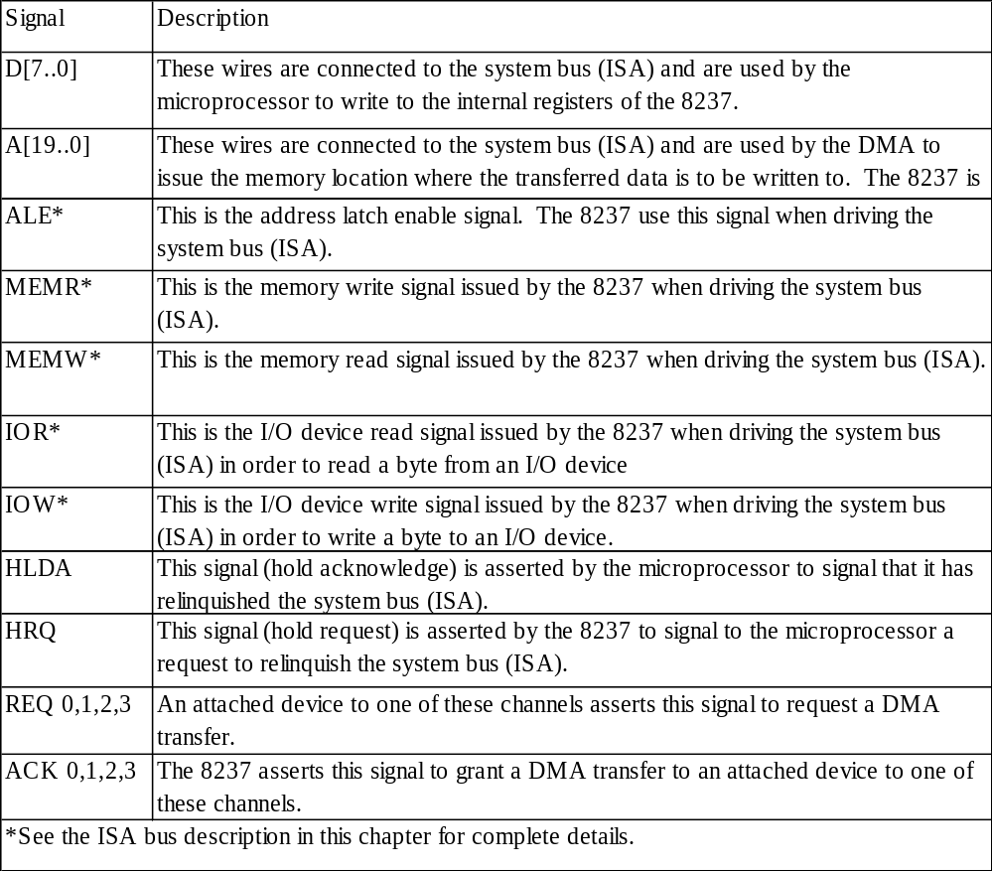
Intel 8237 DMA controller
D[7..0]
A[19..0]
ALE
MEMR
MEMW
IOR
IOW
HLDA
HRQ
Intel 8237
REQ 0
ACK 0
REQ 1
ACK 1
REQ 2
ACK 2
REQ 3
ACK 3

Slide 65
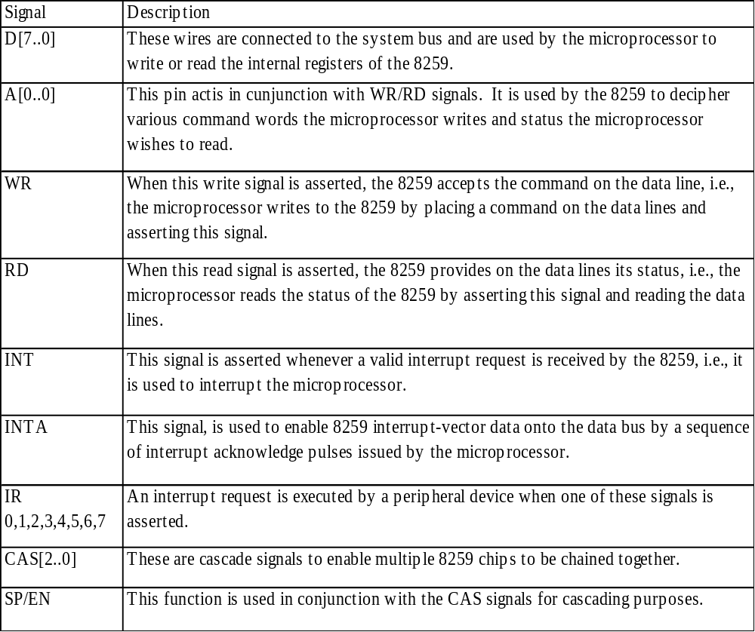
Intel 8259 programmable priority controller
D[7..0]
A[0..0]
RD
WR
INT
INTA
CAS[2..0]
SP/EN
Intel 8259
IR0
IR1
IR2
IR3
IR4
IR5
IR6
IR7

Slide 66
Multilevel bus architectures
Don’t want one bus for all communication
  Peripherals would need high-speed, processor-specific bus interface
    excess gates, power consumption, and cost; less portable
  Too many peripherals slows down bus
Processor-local bus
  High speed, wide, most frequent communication
  Connects microprocessor, cache, memory controllers, etc.
Peripheral bus
  Lower speed, narrower, less frequent communication
  Typically industry standard bus (ISA, PCI) for portability
Micro-
processor
Cache
Memory
controller
DMA
controller
Processor-local bus
Peripheral
Peripheral
Peripheral
Bridge
Peripheral bus
Bridge
  Single-purpose processor converts communication between busses

Slide 67
Advanced communication principles
Parallel communication
In parallel communication, the physical layer carries multiple bits of data at a time. With each wire carrying a single bit, the bus consists of data wires along with control and power lines.
Advantages
High data throughput: Many bits are transferred at a time.
Less complexity: Easily implemented in hardware requiring only a latch to copy data onto a data bus.

Slide 68
Advanced communication principles
Parallel communication
Disadvantages
Long parallel wires can result in Ferranti effect. And according to this effect, there is a voltage build up due to capacitance and voltage at receiving end becomes more than that of sending end.
Little variation in wire length can cause data misalignment as the bits at the receiving ends with reach at different time.
It is more costly to construct and can make system bulky. The cost further increases if insulation of wires to prevent the interference is considered.
Usage
It is used to connect devices which reside on the same circuit board or same IC.

Slide 69
Advanced communication principles
Serial communication
In serial communication, the physical layer carries one bit of data at a time. With all bits of data passing through the single wire, the bus is composed of single data wire along with control and power lines.
Advantages
Significant reduction in the size, the complexity of the connectors and the associated costs.
Throughput can be better for two distant devices as compared to parallel communication of two distant devices.
It does not exhibit Ferranti effect and data misalignments.

Slide 70
Advanced communication principles
Serial communication
Disadvantages
Complex interfacing logic and communication protocols; the data are decomposed into bits at sending end, which must be assembled properly at receiving end.
For short distance communication, its throughput is very less as compared to that of parallel communication.
Usage
It is used to connect distant devices. But it doesn't mean that it cannot be used to connect devices at short distance. However, it is more efficient for distant communications

Slide 71
Advanced communication principles
Wireless communication
In wireless communication, the devices do not need to be connected physically for data transfer.
Infrared and radio frequency channels are used as a physical layer.

Slide 72
Advanced communication principles
Wireless communication
Infrared wave
Infrared wave, which cannot be seen by naked eye, uses electromagnetic wave frequencies that are below the visible light spectrum.
Infrared waves are generated using infrared diode whereas infrared transistors are used to detect the infrared emitted by infrared diode.
Such infrared transistors conduct when exposed to infrared wave.
One advantage of infrared communication is that it is cheap to build transmitters and receivers.
Main disadvantage of this sort of communication is that it requires line of sight between the two devices participating in communication. Also the range of communication is low, which makes it an inefficient method of communication for distant devices

Slide 73
Advanced communication principles
Wireless communication
Radio frequency
Radio frequency uses electromagnetic wave frequencies in the radio spectrum.
For such communication, analog circuitry as well as an antenna is required at communicating devices.
The main advantage of this type of communication is that the line of sight is not required. Also the longer distance communication Is possible.
The range of communication is dependent on the transmission power, But building transmitters and receivers can be complex and costly in Radio Frequency communication.

Slide 74
Advanced communication principles
Layering
layering the communications process means breaking down the communication process into smaller.
Layering can also be viewed as a hierarchical organization of a communication protocol where lower levels of the protocol provide services to the higher levels.
The main objective is to break the complexity of a communication protocol into simple levels which ensures easier handling and simplified design.
The physical layer provides the lower level services of sending and receiving bits or words of data, where as the application layer provides the high level service to the user.

Slide 75
Advanced communication principles
Error Detection and Correction
Error detection is the process of detecting errors that may occur during the transmission of data in any communication process.
Errors can be bit error or burst of bit errors. In bit error, single bit in the transmitted data is invalid. But in case of burst of bit errors, more than one bit gets changed.
Error correction is the process of correcting the bits that were detected during communication process.
Parity and checksum are two basic error correction methods.

Slide 76
Advanced communication principles
Error Detection and Correction
In parity check, extra bit is send along with data to provide additional information about the data. If extra bit makes an odd number of 1s in data word bits plus parity bit then it is referred as odd parity otherwise it will be even parity.
The parity of data must be check at both ends of communication and the parity of the data sent must be same to that of parity of data received.
This type of checking method is efficient for single bit error but can create problems for burst of bit errors as it is not able to detect change in even number of bits.
Example: Data of 7 bits - 0011010
Transmitted data with even parity - 00110101
Received data with parity - 10110101,
it indicates error as it should have an even parity.

Slide 77
Advanced communication principles
Error Detection and Correction
In checksum error checking, multiple words of data in packets are checked for error.
The extra word which represents the XOR sum of all data words in a packet is transmitted along with packet. Though it can be implemented for burst of bits error, it does not account for all error combinations.
The transmitter sends the packet of data along with the checksum word which is checked at receiving end on reception. If the checksum word is correct then it represents successful transmission.
  However, few error combinations can generate the checksum word same as received, in such case the error checking fails.

Slide 78
Advanced communication principles
Error Detection and Correction
Example:
Data words of packet to be transmitted: 010101, 011101, 110011, 101100
Checksum word at transmitter: 010111 (XOR or all data words)
Received checksum word: 010111
Received data words of packet: 110101, 010101, 110011, 101100, error exists
Calculate checksum word at receiver: 111111, checksum does not match, error check success.
Received data words of packet: 010101, 011101, 110011, 101100, error exists
Calculate checksum word at receiver: 010111, checksum match, error check fails.

Slide 79
Serial protocols: I²C
I²C (Inter-IC)
  Two-wire serial bus protocol developed by Philips Semiconductors nearly 20 years ago
  Enables peripheral ICs to communicate using simple communication hardware
  Data transfer rates up to 100 kbits/s and 7-bit addressing possible in normal mode
  7-bit addressing mode can handle 127 devices to communication over share I2C bus
  3.4 Mbits/s and 10-bit addressing in fast-mode
  Common devices capable of interfacing to I²C bus:
    EPROMS, Flash, and some RAM memory, real-time clocks, watchdog timers, and microcontrollers

Slide 80
I2C bus structure
SCL
SDA
Micro-controller
(master)
EEPROM
(servant)
Temp. Sensor
(servant)
LCD-controller
(servant)
< 400 pF
Addr=0x01 Addr=0x02 Addr=0x03
SDA
SDA
SDA
SDA
SCL
SCL
SCL
SCL
Start condition
Sending 0
Sending 1
Stop condition
From Servant
From receiver
D
C
ST
ART
A6
A5
A0
R/w
ACK
D8
D7
D0
ACK
ST
OP
Typical read/write cycle

Slide 81
Serial protocols: CAN
CAN (Controller area network)
  Protocol for real-time applications ,Developed by Robert Bosch GmbH
  No host required
  CAN bus is a Broadcast type of bus
  Message based protocol
  Serial half duplex asynchronous communication
  Differential two wired communication
  Originally for communication among components of cars
  Applications now using CAN include:
    elevator controllers, copiers, telescopes, production-line control systems, and medical instruments
  Data transfer rates up to 1 Mbit/s and 11-bit addressing
  Common devices interfacing with CAN:
    8051-compatible 8592 processor and standalone CAN controllers

Slide 82
Serial protocols: FireWire
FireWire (a.k.a. I-Link, Lynx, IEEE 1394)
  High-performance serial bus developed by Apple Computer Inc.
  Designed for interfacing independent electronic components
    e.g., Desktop, scanner, Digital camera
  Data transfer rates from 12.5 to 400 Mbits/s, 64-bit addressing
  Plug-and-play capabilities
  Packet-based layered design structure
  Applications using FireWire include:
    disk drives, printers, scanners, cameras

Slide 83
Serial protocols: USB
USB (Universal Serial Bus)
  Easier connection between PC and monitors, printers, digital speakers, modems, scanners, digital cameras, joysticks, multimedia game equipment
  2 data rates:
    12 Mbps for increased bandwidth devices
    1.5 Mbps for lower-speed devices (joysticks, game pads)
  Tiered star topology can be used
    One USB device (hub) connected to PC
      hub can be embedded in devices like monitor, printer, or keyboard or can be standalone
    Multiple USB devices can be connected to hub
    Up to 127 devices can be connected like this
  USB host controller
    Manages and controls bandwidth and driver software required by each peripheral
    Dynamically allocates power downstream according to devices connected/disconnected

Slide 84
Parallel protocols: PCI Bus
PCI Bus (Peripheral Component Interconnect)
  High performance bus originated at Intel in the early 1990’s
  Standard adopted by industry and administered by PCISIG (PCI Special Interest Group)
  Interconnects chips, expansion boards, processor memory subsystems
  Data transfer rates of 127.2 to 508.6 Mbits/s and 32-bit addressing
    Later extended to 64-bit while maintaining compatibility with 32-bit schemes
  Synchronous bus architecture
  Multiplexed 32-bit data/address lines

Slide 85
Parallel protocols: ARM Bus
ARM Bus (Advanced RISC machine)
  Designed to connect and manage different functions block in a system on chip(SoC)
  Designed and used internally by ARM Corporation
  Interfaces with ARM line of processors
  Support 32-bit data transfer and 32-bit addressing similar to PCI is implemented using synchronous data transfer architecture
  Data transfer rate is a function of clock speed
    If clock speed of bus is X, transfer rate = 16 x X bits/s

Slide 86
Wireless protocols: IrDA
IrDA (Infrared Data Association)
Protocol suite that supports short-range point-to-point infrared data transmission
Created and promoted by the Infrared Data Association (IrDA)
Data transfer rate of 9.6 kbps and 4 Mbps
IrDA hardware deployed in notebook computers, printers, PDAs, digital cameras, public phones, cell phones
Lack of suitable drivers has slowed use by applications
Microsoft windows CE 1.0 was the first windows operating systems to provide built in IrDA support
Becoming available on popular embedded OS’s

Slide 87
Wireless protocols: Bluetooth
Bluetooth
  Created by telecom vender ericsson in 1994
  New, global standard for wireless connectivity
  Based on low-cost, short-range radio link
  Connection established when within 10 meters of each other
  No line-of-sight required
    e.g., Connect to printer in another room

Slide 88
Wireless Protocols: IEEE 802.11
IEEE 802.11
IEEE 802.11 is a set of media access control (MAC) and physical layer (PHY) specifications for implementing wireless local area network.
IEEE 802.11, often termed as Wi-Fi, has the data transfer rate of around 1-2Mbps.
IEEE 802.11 has a variety of standards, each with a letter suffix; 802.11a, 802.11b, 802.11g, 802.11n standards are quite common.
Generally, 2.4 GHz band is common which also makes the chips easier and cheaper to manufacture.
The data rate can go up to 54 Mbps with some standard, while few latest standards may support up to 6.75 Gbit/s.

Slide 89
Wireless Protocols: IEEE 802.11
IEEE 802.11
The PHY layer defines the means of transmitting bits over a physical link connecting network nodes.
It provides an electrical, mechanical and procedural interface to the transmission medium.
Modulation, line coding, synchronization are few functions, out of many, performed by the physical layer.
The MAC layer provides the addressing and channel access control mechanism that ensures the communication of several nodes within a shared medium.
Each device is assigned a unique serial number which is also known as MAC address.
Unique MAC address makes it possible for data packets to be delivered to a destination within a sub-network.

